Slide 1
Nazik Araba Heymann
Web Tech Fall 2021 Final Exams

Slide 2
Nazik is developing a data powered website to help the Ghana Education Service easily place junior high students in their rightful senior high schools based on their final grades.

Slide 3
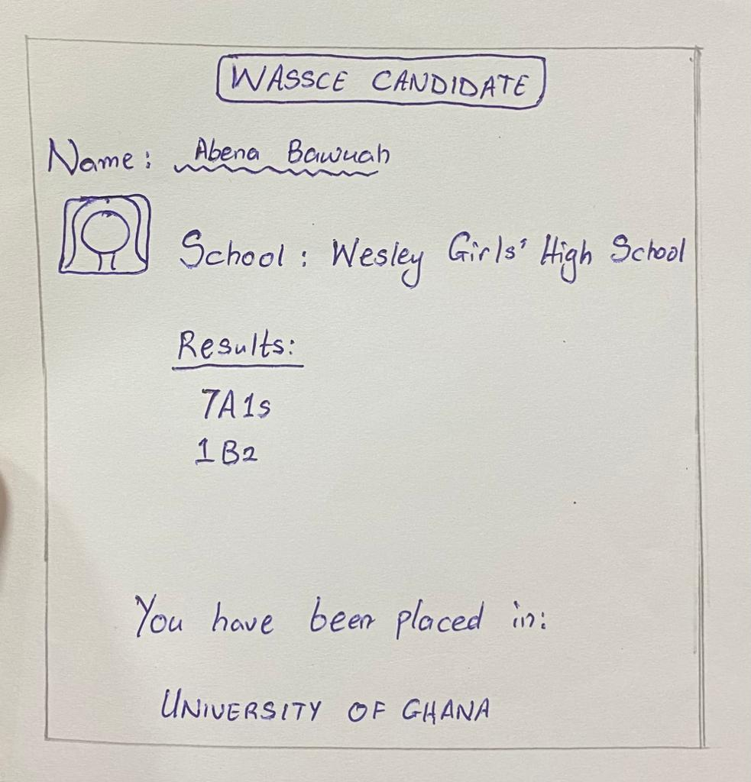
School Placement System
ddd
PERSONA(s)
The GES personnel involved in the placement
JHS students, parents, teachers
PROBLEM:
The website will make checking the results of students and the schools they have been placed in more convenient.
PAYOFF: This is a drawn image of the page showing the results of a BECE canidiate
FINISH: The users are better off because they can access all the information concerning their grades and placement from the comfort of their homes.

Slide 4
User / Customer
describe the business, organization, or group of people that will use this website. If a business, describe its products or services and what its purpose is.
What are the roles of the users who will use the website. One sentence about what they do. For example, in the Attendance system the roles are “students”, “faculty” and “faculty interns”.
Roles
Students – Check their results online and in which school they have been placed.

Slide 5
Main Functions of the Website
3- 4 functions that will be built to solve the problem.
Allow candidates to sign up to the site
Place candidates in their respective schools
Allow an admin to add and delete users

Slide 6
Architecture
Image of 3 tier architecture and how they connect, programing languages for each tier and why, other technologies (frameworks, etc).
The presentation layer is where the end user interacts with the application by viewing and entering information into the system.
The application layer is where the information processing takes place.
The data layer is where data related to the application is stored.
Presentation layer
Data layer
Application layer
< ----- HTML, CSS, Javascript
< ----- PHP
< ------MySQL

